Slide 1
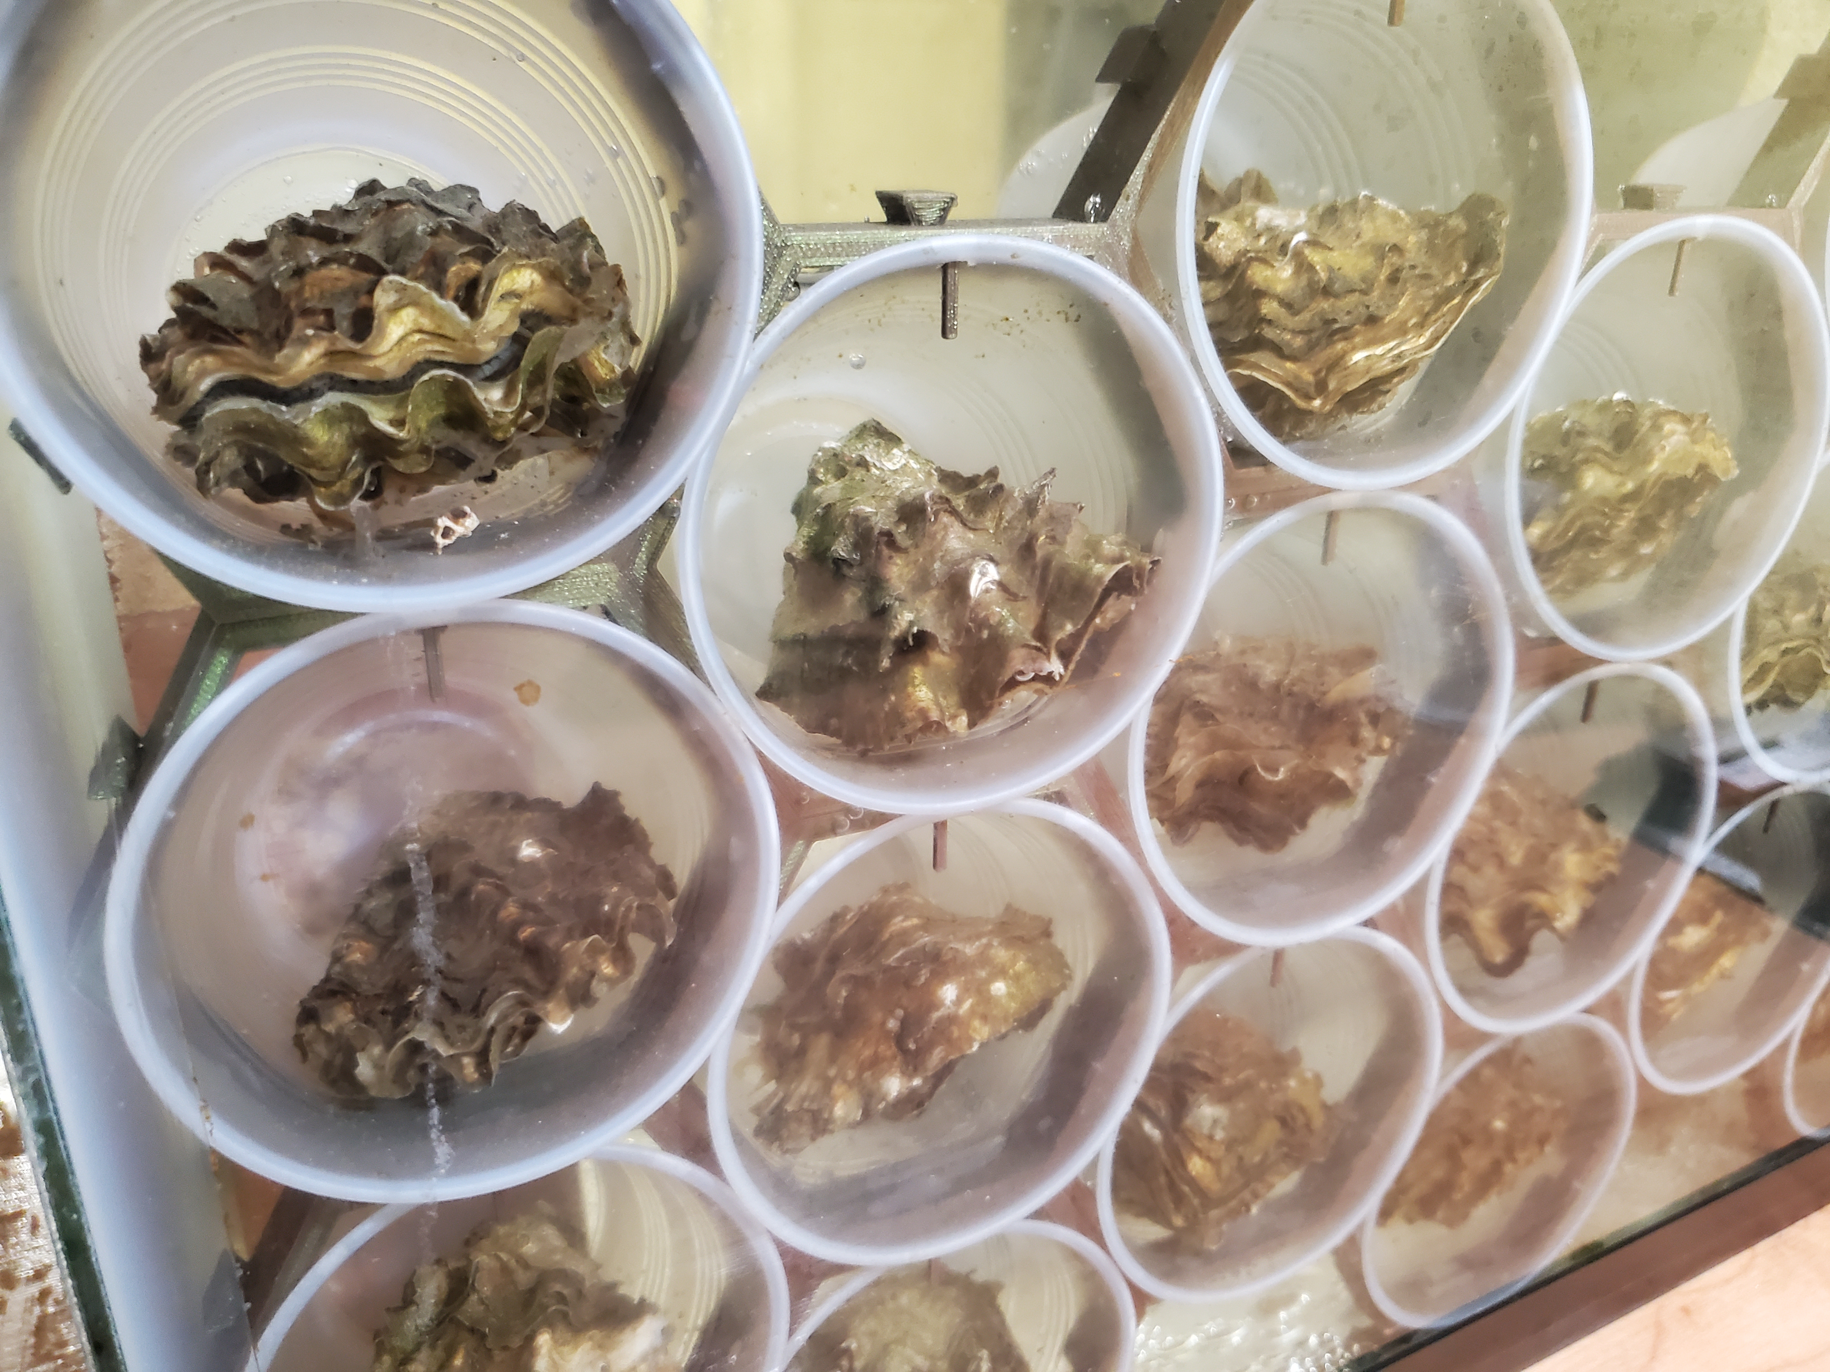
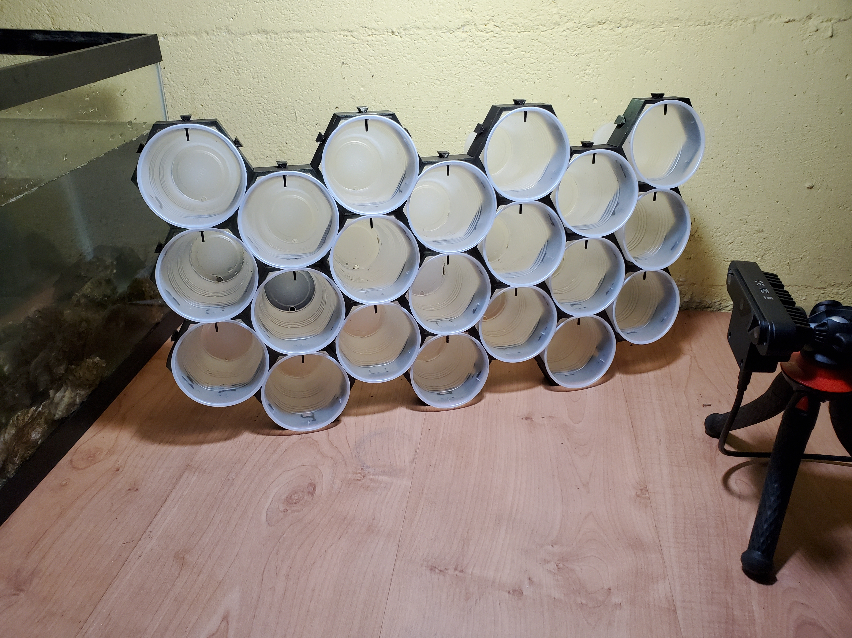


SEAi-MORE A ShEllfish BehAvior MOnitoRing DEvice Streamlit Web App Instructions
AI Is a Team Sport!!!
‘The Oly Shuckers’
Brandon Sackmann, Ph.D.
Kenia Whitehead, Ph.D. * Hannah Podzorski
Whitney Godwin * Beatrice Li * Emerson Sirk
Andy Suhrbier (Pacific Shellfish Institute)
9 August 2021

Slide 2

SEAi-MORE – Installation
Download app: SEAi-MORE GitHub repository
Download sample images (n = 100): OneDrive
Install Streamlit
Open command prompt; change to directory that contains the app: SEAi-MORE_OpenCV.py
Run the app: > streamlit run .\SEAi-MORE_OpenCV.py
Open web browser: http://localhost:8501
* Full-resolution versions of the instructional videos included in this presentation are available on the SEAi-MORE GitHub Repository.

Slide 3
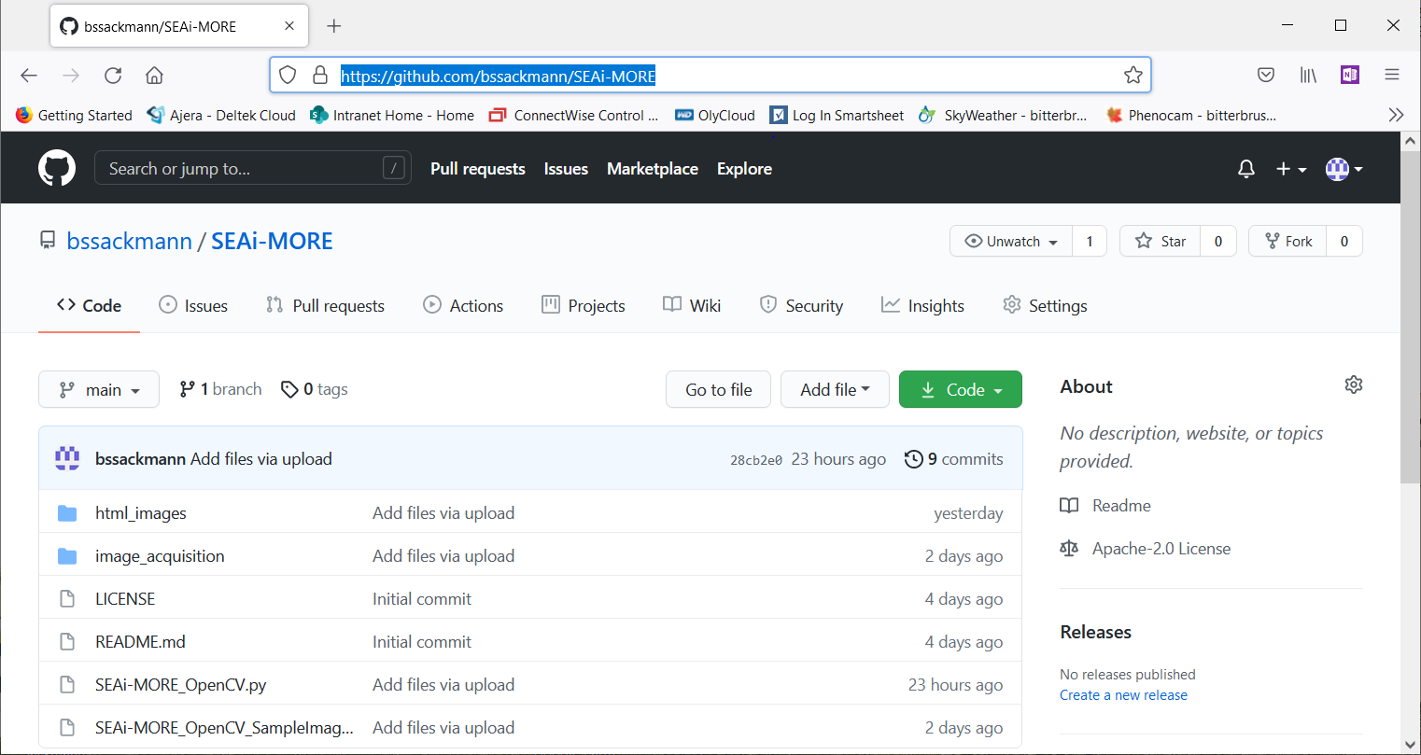
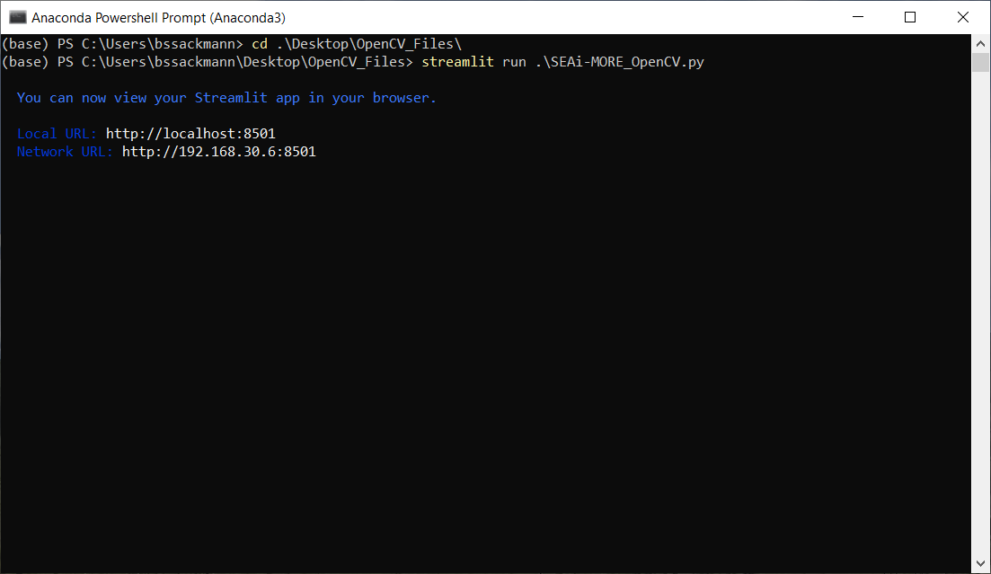
SEAi-MORE – Installation
Change directories
Launch app
Open Browser

Slide 4
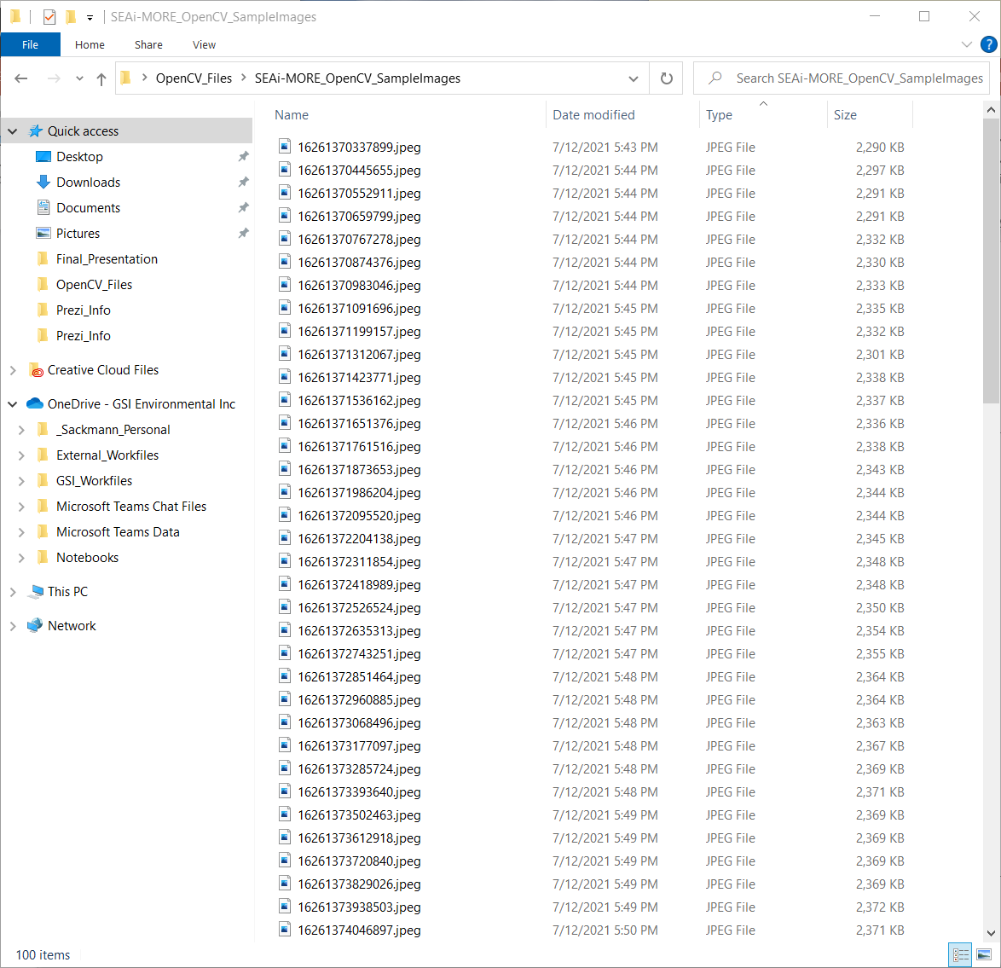
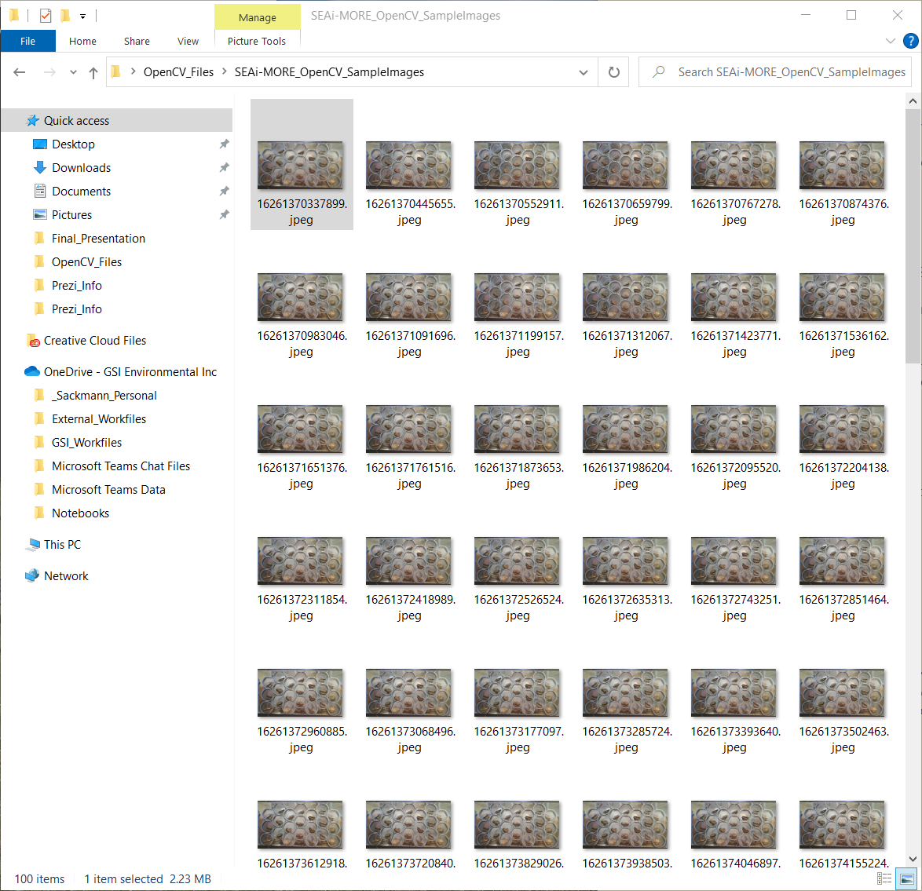
SEAi-MORE – Sample images (n = 100)

Slide 5
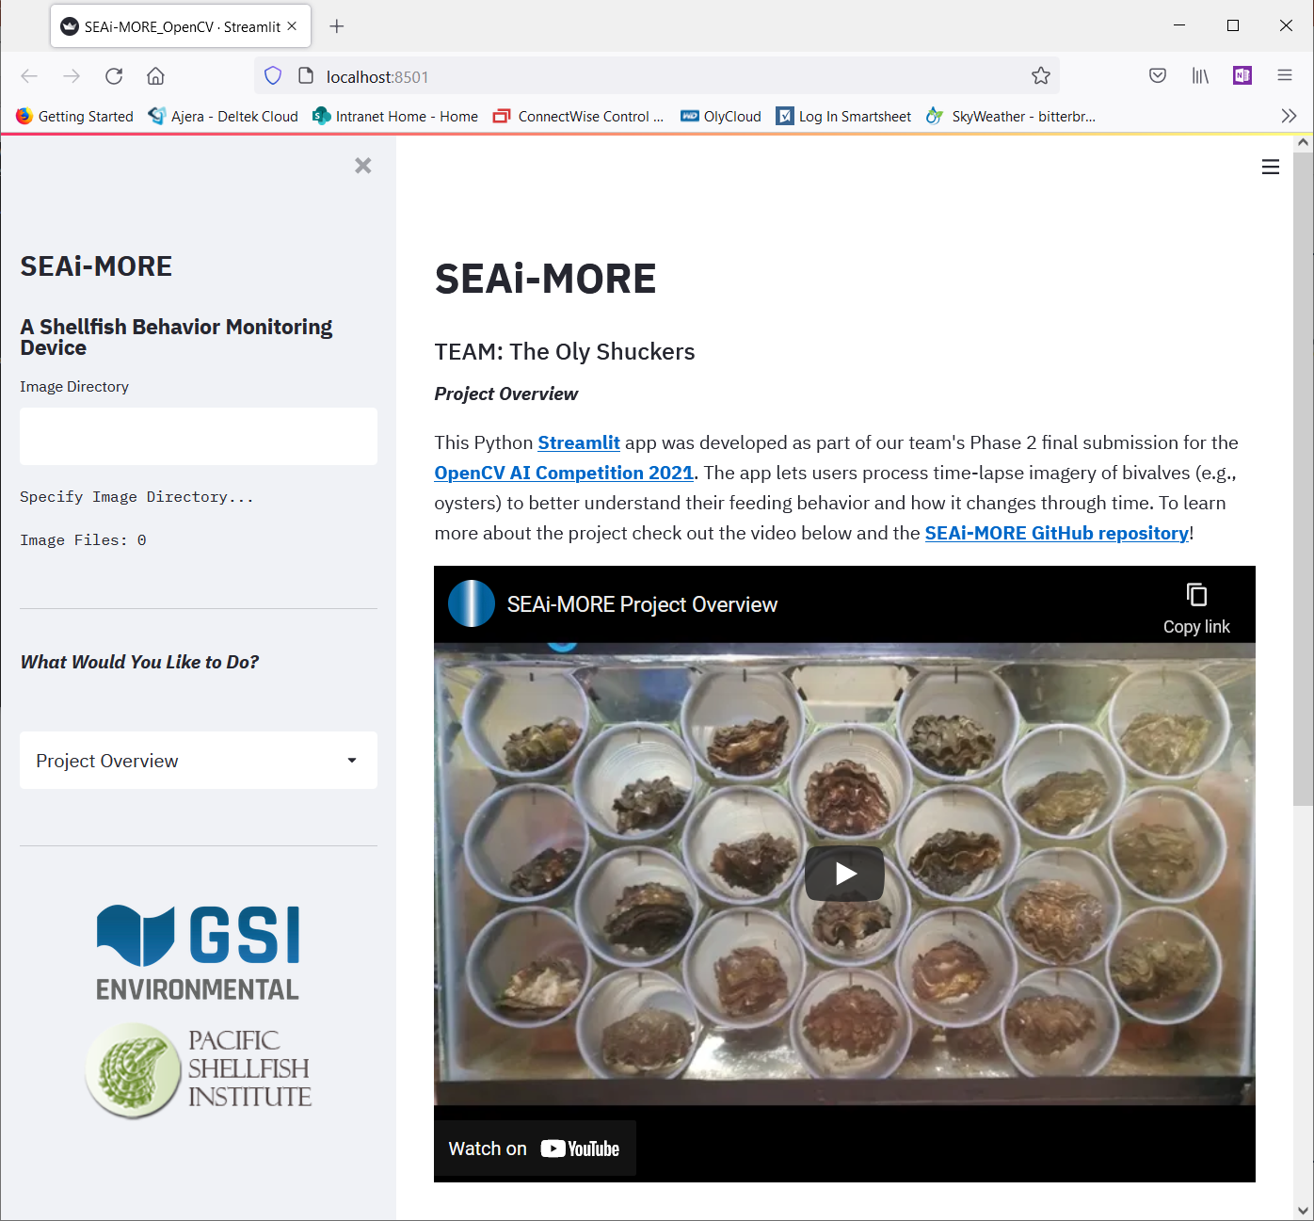
SEAi-MORE – WEB APP Overview
App has 4 separate ‘modules’ (see drop-down box in left-hand sidebar)
Project Overview
Pre-processing & Inference
Annotation Review
Post-processing & Time Series Analysis

Slide 6
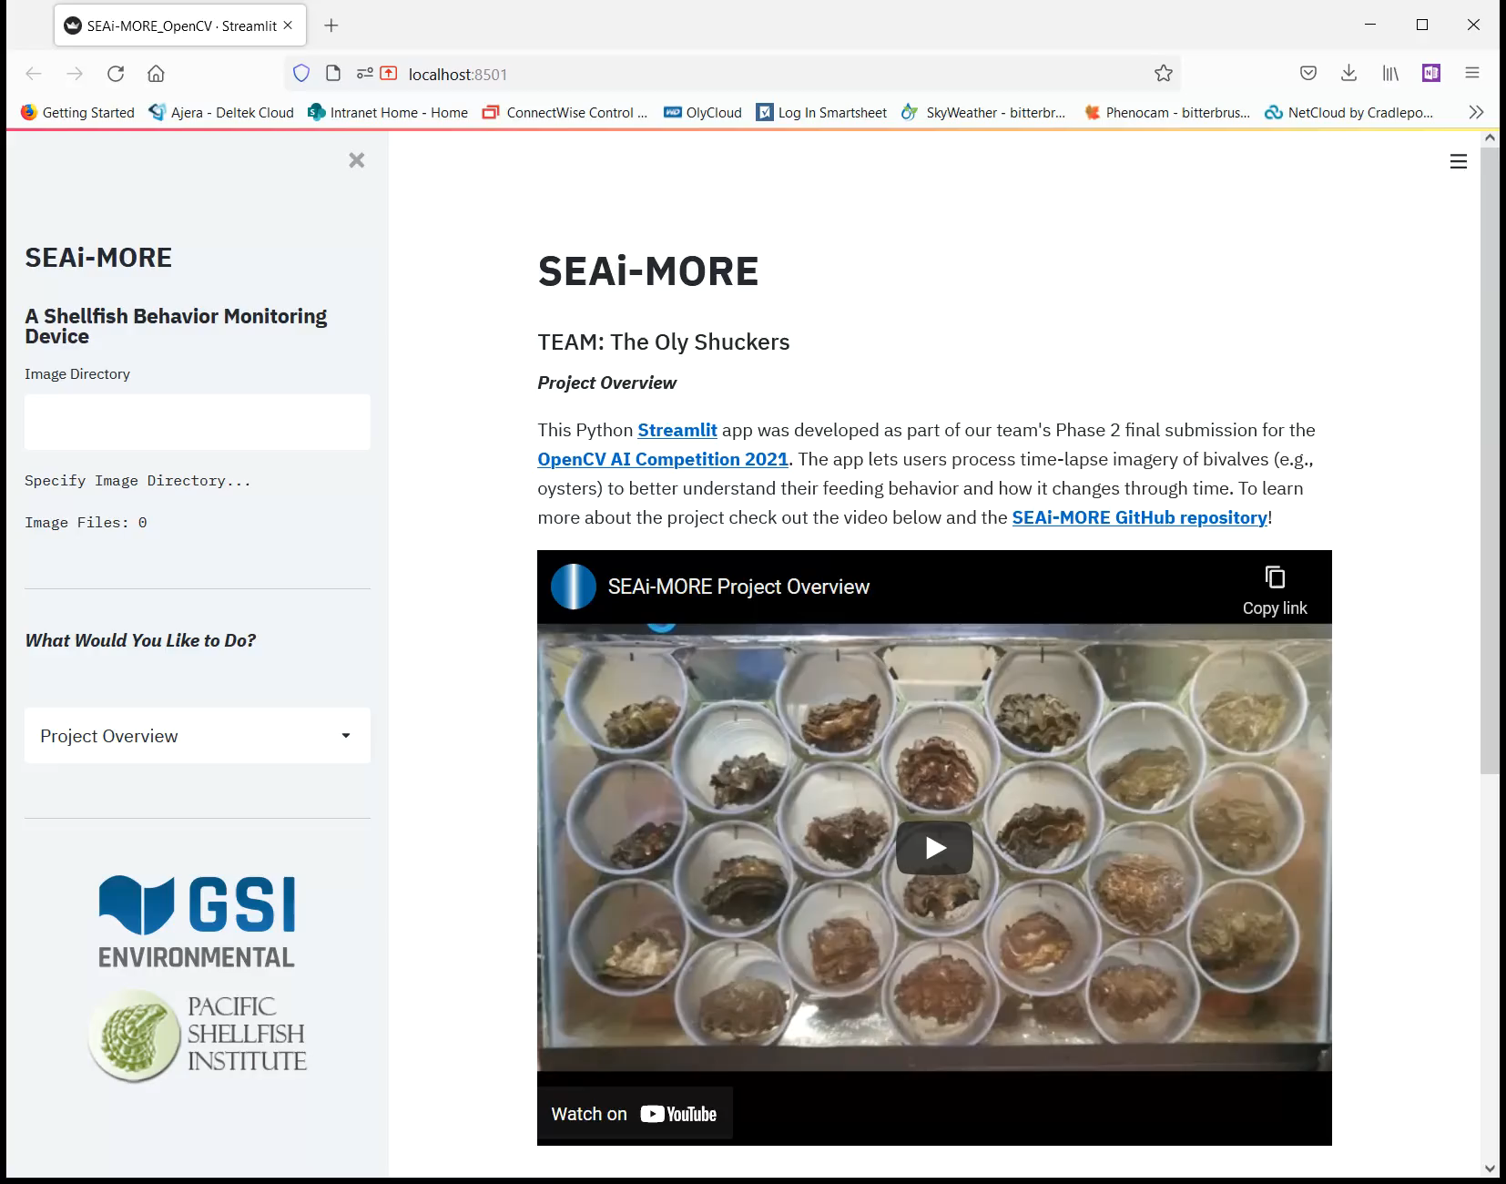
SEAi-MORE – project overview
Initial app landing page
Provides overview and general information about the SEAi-MORE project

Slide 7
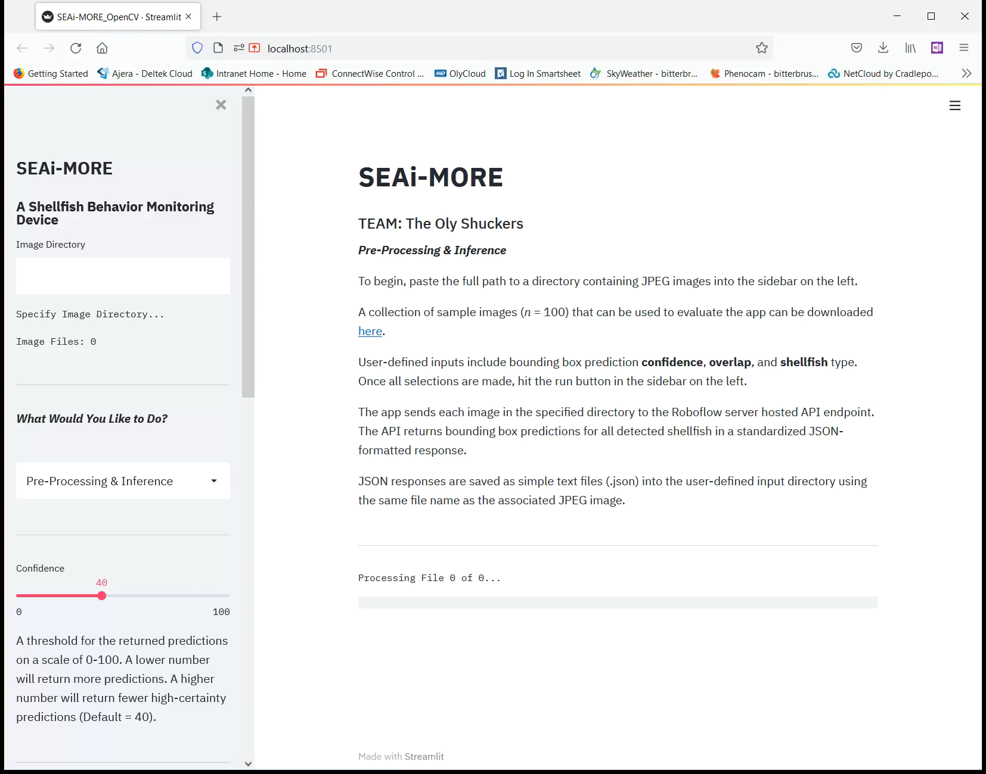
SEAi-MORE – Pre-processing & inference
Users specify input directory of images for processing using the Roboflow server hosted API endpoint
Exposes user-defined inputs to adjust arguments used during API calls

Slide 8
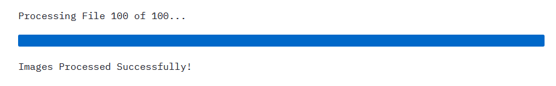
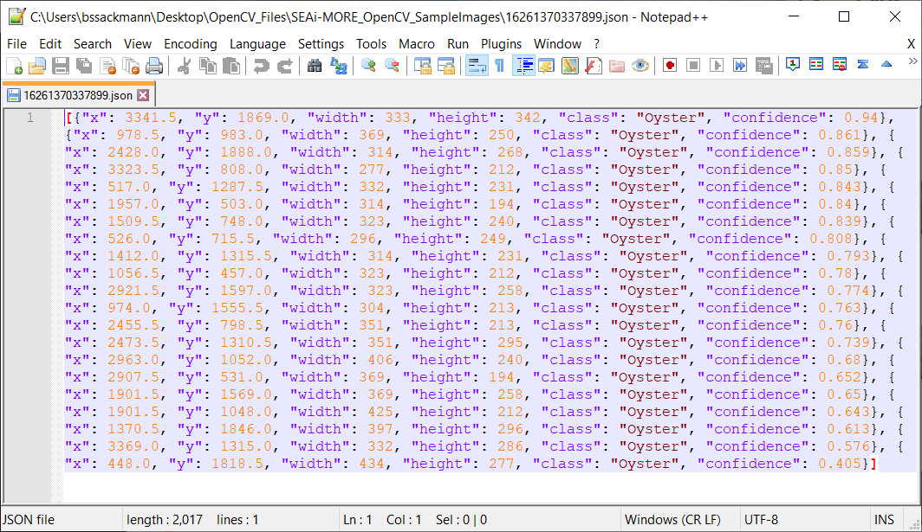
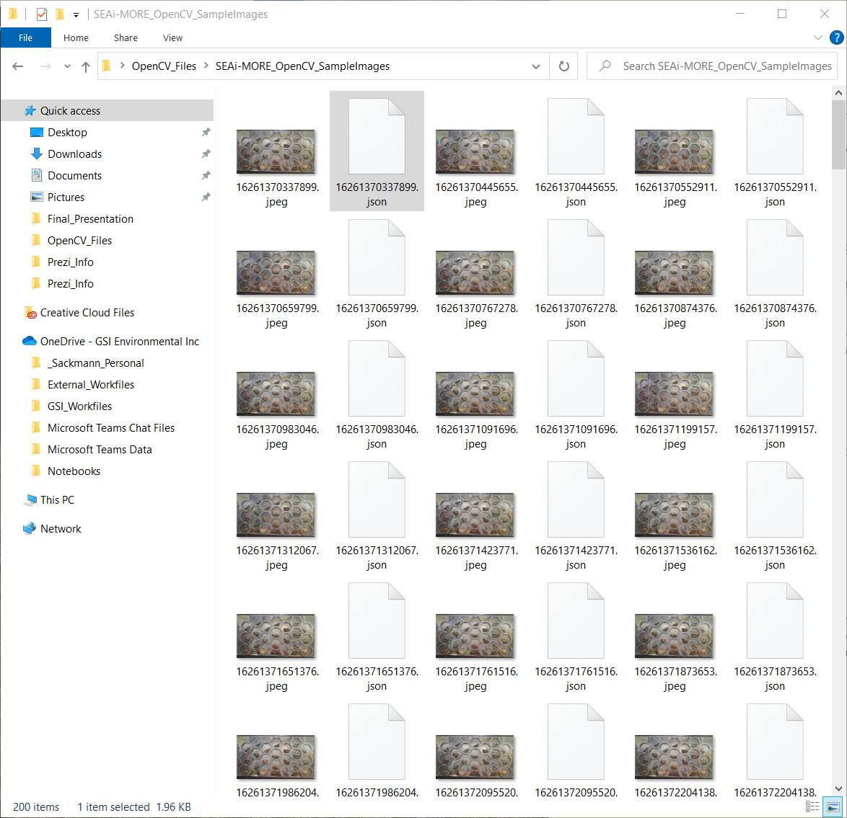
SEAi-MORE – Pre-processing & inference

Slide 9
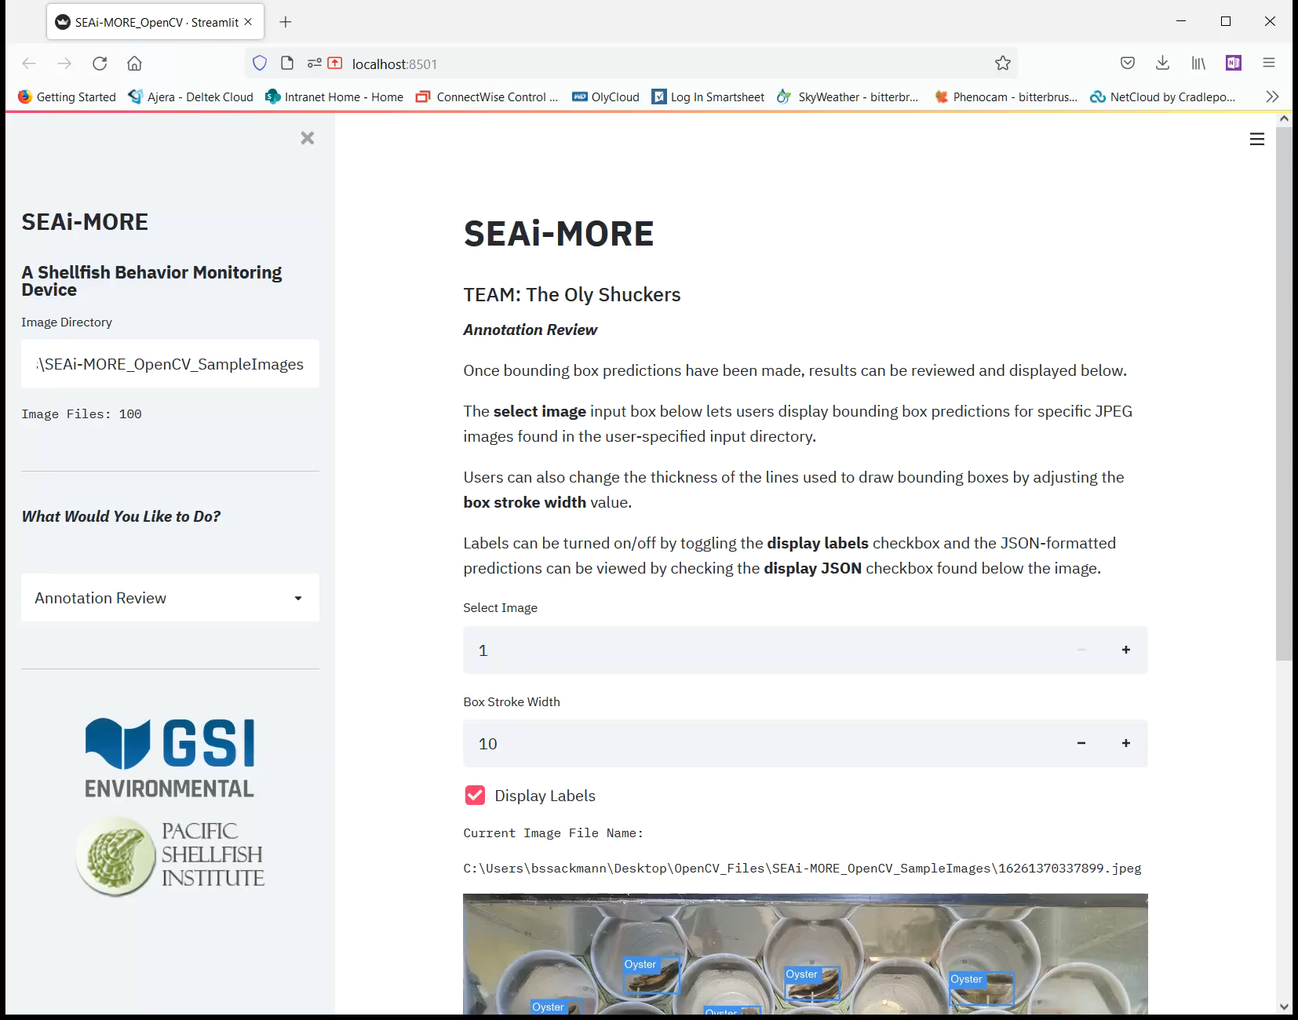
SEAi-MORE – Annotation review
Users review and visualize bounding box predictions returned by the Roboflow server hosted API endpoint

Slide 10
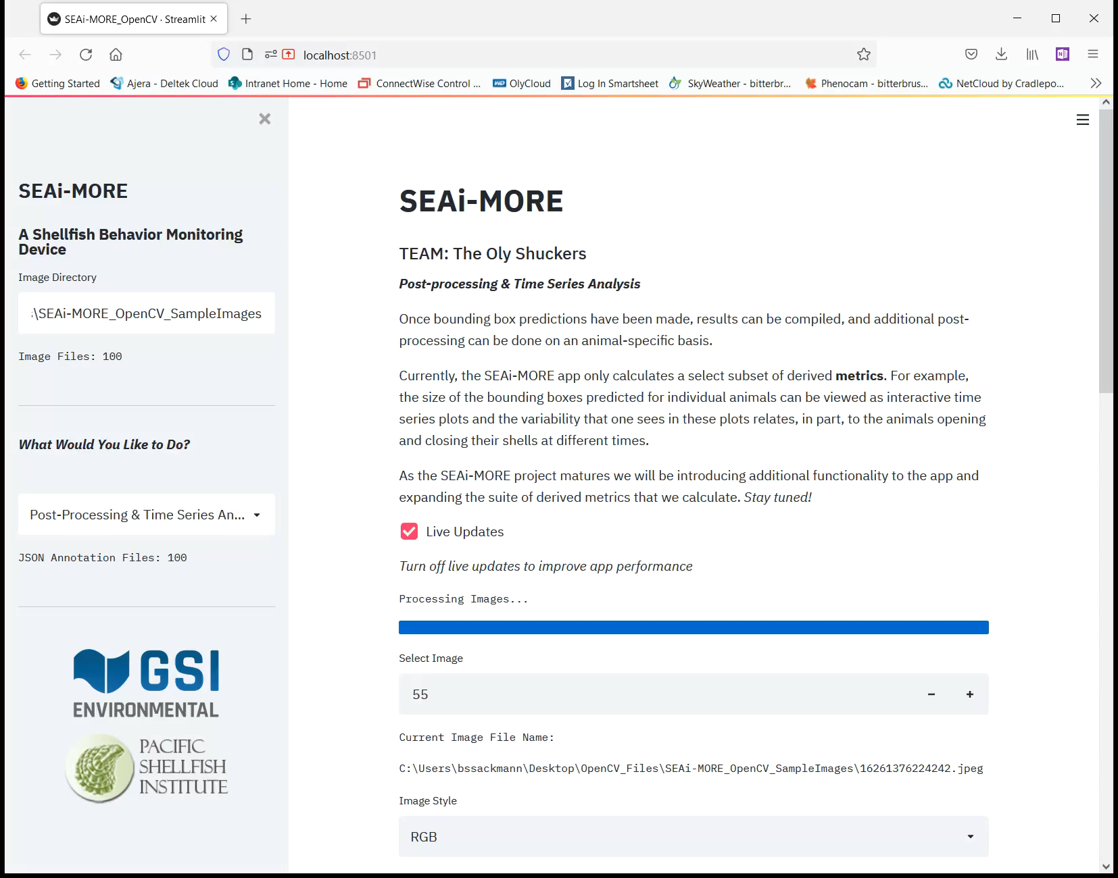
SEAi-MORE – Post-processing & Time Series Analysis
Users calculate animal-specific summary statistics to better understand their animals’ feeding behavior and how it changes through time
Results are visualized as time series using interactive Plotly graphs

Slide 11
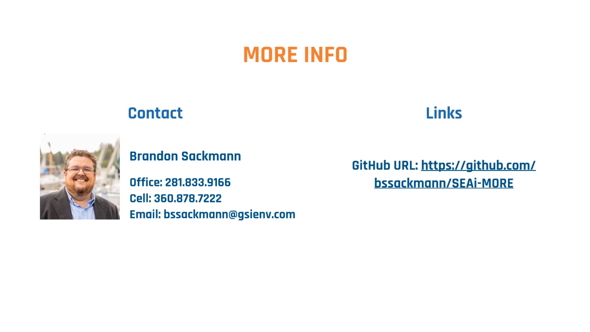
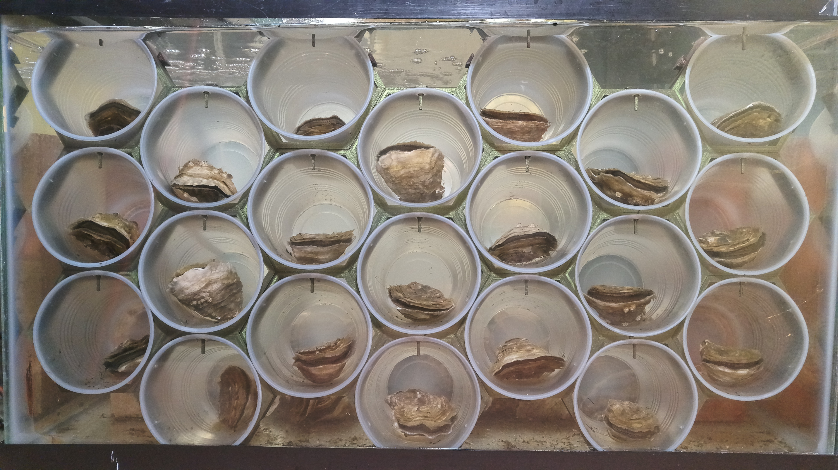

questions

